Slide 1
Team 8: BARTS
Tyler Cabutto, Brandon Little, Andrew simpson, Robert walker

Slide 2
Overview
An auction system that has been made to be in the format of a website to accommodate both basic users, and more of the higher end users such as avid auctioneers, or businesses.
This approach is made to make it easier to hold private (or silent) auctions online on a more accessible domain instead of having to travel and meet in person. It will also maintain features from other popular sites that people still love.

Slide 3
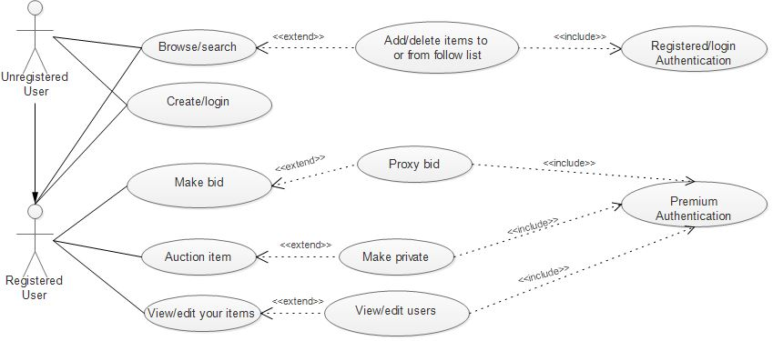
Use Case Diagram

Slide 4
Use-Case Descriptions

Slide 5
Use Case ID | 01
Use Case Name | Create/Login
Actor(s) | User
Precondition(s) | 1- The user is not currently logged in 2- A user has not registered for a account 3- The user has a item he wants to put up for auction, make a bid, and view their items.
Postcondition(s) | 1- a registered user will be logged in 2- unregistered user gains access to sites features dependent on what level they sign up for.
Normal Flow | 1- Go to website. 2- User is greeted with software home page. 3- Click log in or create account. 4- enter credentials. 5- Loads personalized home page and all features available. 6- Log out or close window.
Alternate Flow(s) | 3a If the user is unregistered: User will be prompted to create an account Enter required credentials (e-mail, first and last name, username, password, date of birth (18 or older) ). 3b If user tries creating account: Will be prompted account already exists. Will be prompted to log in.
Exception(s) | 4a If the user cannot log in: Two accounts cannot be logged in at the same time. User enters wrong password. User types invalid username/email, or leaves blank. 4b If user cannot create a account invalid e-mail Username already taken password requirements not met or exceeded. User is not 18 or older Multiple accounts with the same information cannot exist.

Slide 6
Functional Requirements
Use Case Number | 2
Requirement | This shall allow the registered user to create a auction of an item of their choosing. This can be done from the home page after they have logged in. i. They shall also be allowed to make the auction private if they are a premium registered user. They will have a check box to choose to make it private, and will be prompted to create a password of which they can share to the buyers that they would like to gain access to the auction.
Non-Function Requirements
Number | 2.2
Requirement | Premium Registered User Authentication
Verification | Verify if the registered user has premium access to the features they are requesting by checking the database.

